Slide 1
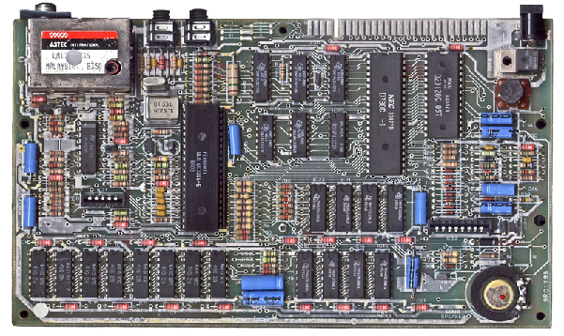

ENGR 151
An (accelerated) introduction to computers and programming
Lecture 2 - MATLAB: Vectors, Matrices and Functions

Slide 2
Recap
Human idea -> Algorithm -> Programming language -> Machine code
MatLab environment: Script Editor; Command Window; Workspace; Current Folder
Read/Evaluate/Display loop for MatLab to process a statement
Data types: weakly-typed
Basic operations and precedence
Notes:
Initialize other types (int8)
Variable name: case sensitive

Slide 3
Contents
Creating Vectors, Matrices
Vector and Matrix Operations
Scripting and Functions

Slide 4
MATLAB is a linear algebra package at its core
MATrix LABoratory
Its basic datatype is an array
An array is a data structure consisting of many data identified by an index
Can visualize an array by imagining individual data stored in boxes that are labelled by a number:
value =
10
1.41
3423
345
0.013
index =
1
2
3
4
5
A linear array

Slide 5
MATLAB’s basic data type is an array
A 2D array (matrix)
a11
a12
a13
a14
a15
a21
a22
a23
a24
a25
A 1 element array (scalar)
a31
a32
a33
a34
a35
a
A 3D array (rank-3 tensor)
A linear array (vector)
a113
a123
a131
a143
a153
a112
a122
a132
a142
a152
a1
a2
a3
a4
a5
a213
a223
a233
a243
a253
a111
a121
a131
a141
a151
a212
a222
a232
a242
a252
a313
a323
a333
a343
a353
a211
a221
a231
a241
a251
a312
a322
a332
a342
a352
a311
a321
a331
a341
a351
Notes:
Tensor - multidimensional array
4D array (e.g., with time)

Slide 6
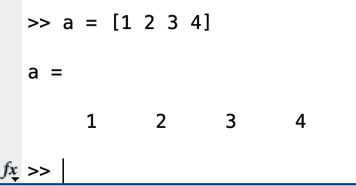
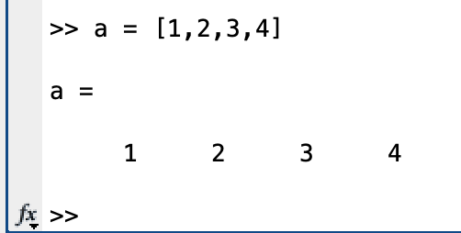
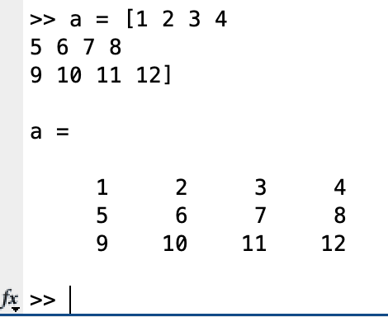
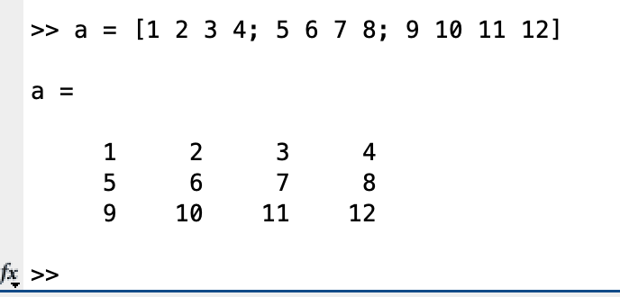
Creating arrays
The square bracket [ ] creates an array when data is entered
, or <space> separates columns, ; or <return> separates rows
A linear array (row vector)
A 2D array (matrix)
Notes:
Demo the four cases
around 12:10 would be best

Slide 7
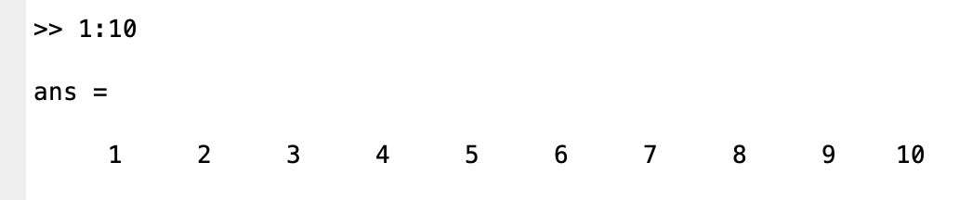
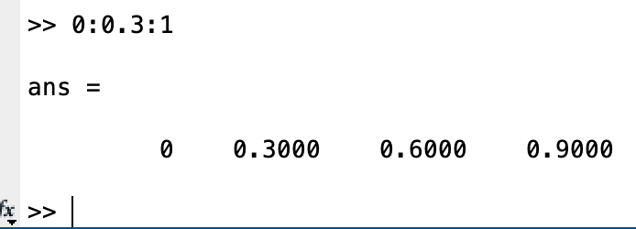
Creating arrays
Use the colon (:) operator to create evenly-spaced linear arrays
first:last
array of values from first to last spaced by 1
first:step:last
array of values from first to last spaced by step

Slide 8
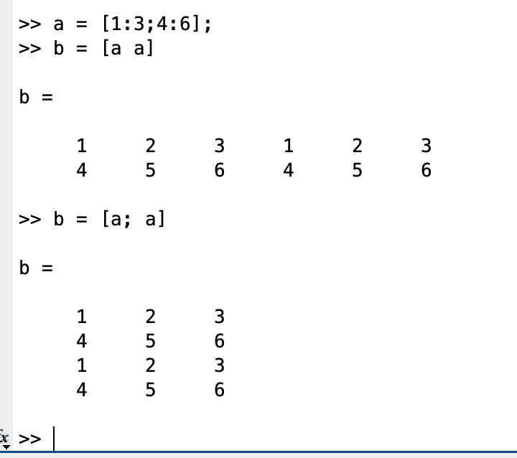
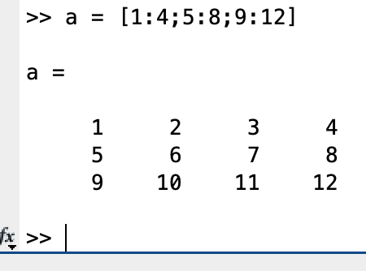
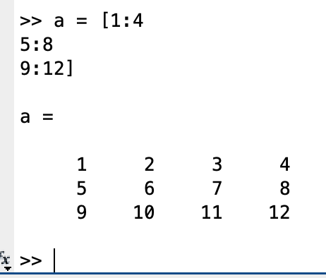
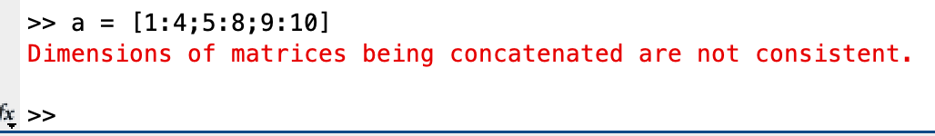
Creating arrays
Use square bracket and colon operators to generate more complex array structures:
A 2D array (matrix)
Error if rows / columns not the same length….

Slide 9
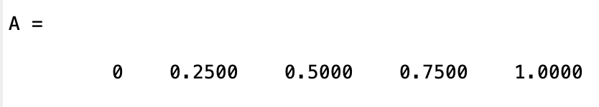
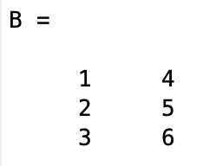
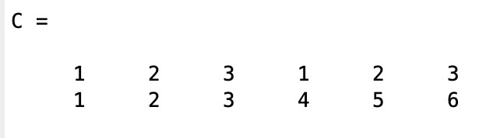
Challenge: array building
Use the colon (:) and bracket [] operators to create the following arrays:

Slide 10
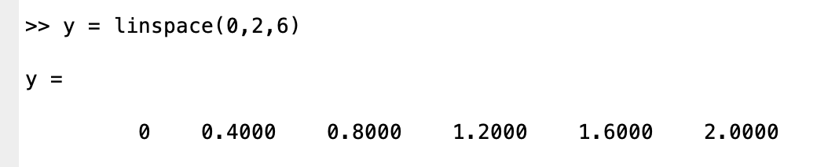
Creating arrays
Use linspace to generate 1-D arrays:
y = linspace(x1,x2,n) generates n points starting at x1 and ending at x2

Slide 11
Creating arrays
Use meshgrid to generate multidimensional arrays:
[X,Y] = meshgrid(x,y) returns 2-D grid coordinates based on the coordinates contained in vectors x and y.
y
5
4
3
2
1
x
0
10
20
30
Notes:
Use linspace to create x and y

Slide 12
Other ways of making arrays
zeros - a matrix of zeros of size sz1x…szN X = zeros(sz1,...,szN)
ones - a matrix of ones of size sz1x…szN X = ones(sz1,...,szN)
eye - the identity matrix of size n X = eye(n)
…

Slide 13

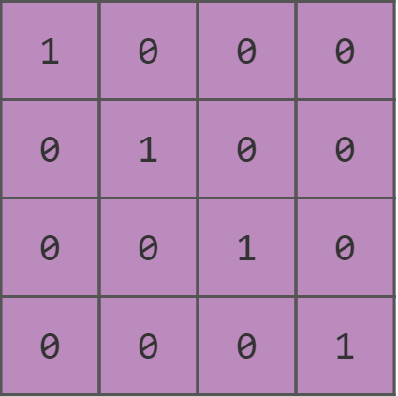
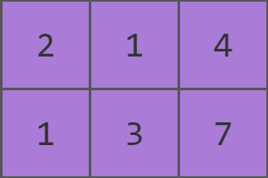
size, length, and numel functions
numel(x) : # of elements in x.
length(x): # of elements along the longest dimension of x.
size(x): vector with the # of elements along each dimension
numel: 6 length: 3 size: [2,3]
numel: 3 length: 3 size: [3,1]
numel: 16 length: 4 size: [4,4]
Notes:
around 12:30 would be best

Slide 14
Contents
Creating Vectors, Matrices
Vector and Matrix Operations
Scripting and Functions

Slide 15
Matrix/vector Operations
MATLAB allows us to perform standard matrix/vector operations on arrays:
Addition A + B
Subtraction A – B
Multiplication A * B (# cols in a must equal # rows in b)
Right Division A / B (each must have same # columns)
Left Division B \ A (each must have same # rows)
Exponentiation A ^ n (A must be square)
A & B matrices / vectors
n is scalar
Notes:
Demo:
A + B
A - B
A * B
but others require background of linear algebra.

Slide 16
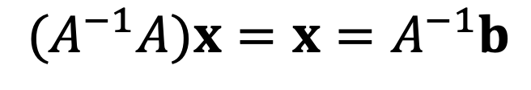
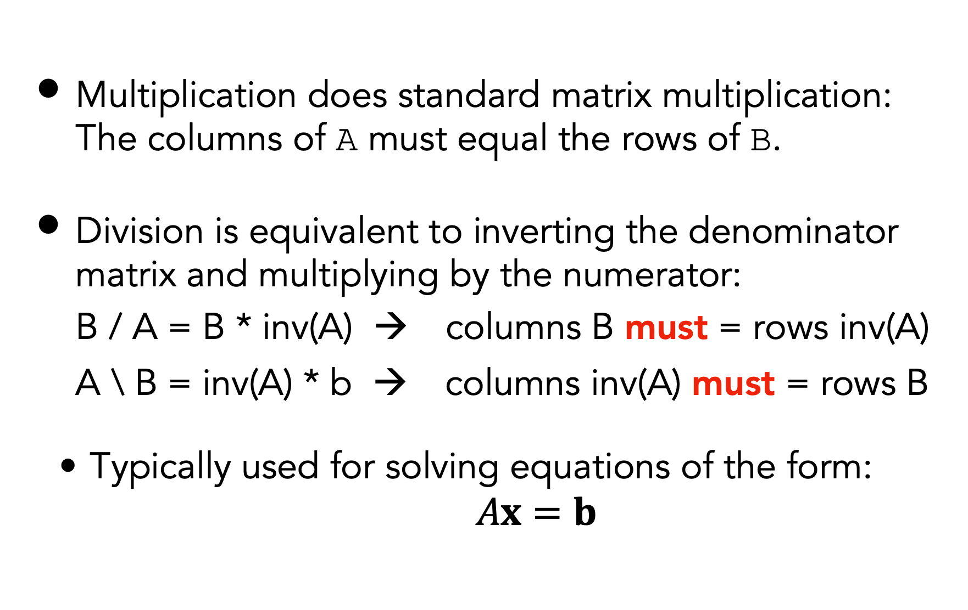
Matrix/vector Operations
Multiplication does standard matrix multiplication: The columns of A must equal the rows of B.
Division is equivalent to inverting the denominator matrix and multiplying by the numerator:
B / A = B * inv(A) → columns B must = rows inv(A)
A \ B = inv(A) * b → columns inv(A) must = rows B
Typically used for solving equations of the form: $Ax=b$
$$(A^{−1}A)x=x=A^{−1}b$$

Slide 17
Array Operations
MATLAB allows us to perform element-wise operations on the array:
Addition A + B
Subtraction A – B
Multiplication A .* B
Right Division A ./ B
Left Division A .\ B
Exponentiation A .^ B
These are all binary operations
The dot .
A and B must be the same size
Notes:
.+ or .- are invalid because it is the same as + and -
Demo: .* ./ .\ .^

Slide 18
Challenge: array operations
Calculate the following
The first 10 square numbers (integers squared)
The cosine of the elements of A
Notes:
cos(A)

Slide 19
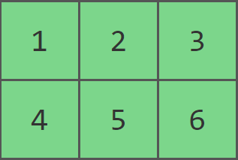
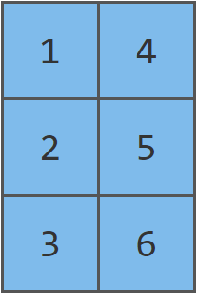
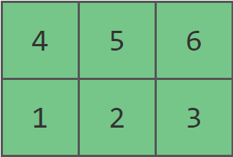
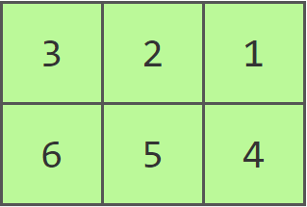
Transpose, flipud, fliplr
The transpose operation (') takes a matrix/vector and exchanges rows and columns
The flipud ("flip up/down") and fliplr ("flip left/right") functions reverse all columns or rows.
x
x'
flipud(x)
fliplr(x)
Notes:
Transpose: x to x’ first row (1,2,3) becomes the first column
flipped: first row becomes the last row
flipper: first column becomes the last column

Slide 20
Sum,cumsum
Sum elements along direction given by dim - or over all directions with ‘all’
S = sum(A)
S = sum(A,'all')
S = sum(A,dim)
Cumsum is cumulative summation of elements along direction given by dim
B = cumsum(A)
B = cumsum(A,dim)
Notes:
dim = 1 sum for each row dim = 2 sum for each column
demo

Slide 21
Diff
Diff finds difference between adjacent elements in direction dim
Y = diff(X)
Y = diff(X,n)
Y = diff(X,n,dim)
a2 - a1
a3 - a2
a4 - a3
a5 - a6
a1
a2
a3
a4
a5
Notes:
Why there are so many built-in functions for matrix operation?

Slide 22
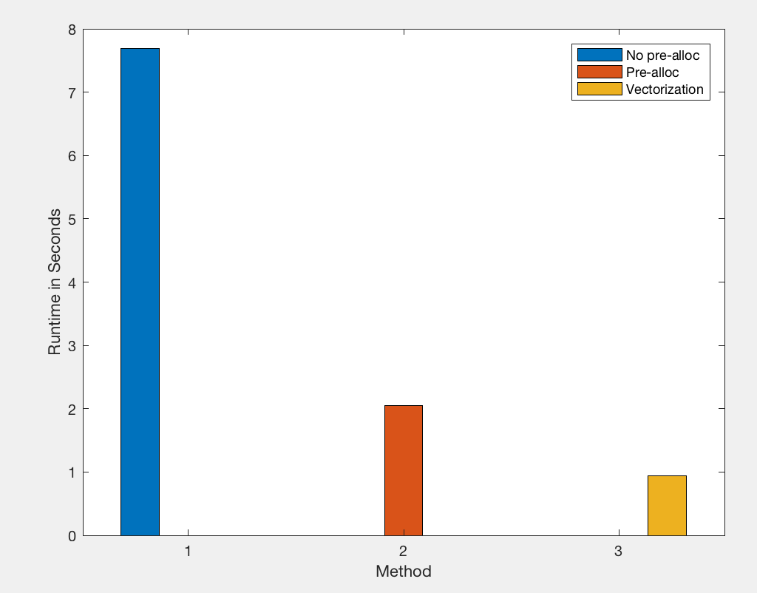
Vectorization
Vectorization means to apply operations to whole arrays instead of individual elements
A reason for using vectorized functions and operations in MATLAB is speed - operations on arrays are highly optimized
Inbuilt functions (such as sin) are all vectorized and will act on a whole array
Notes:
Vectorization
Loop: Most programming languages provide mechanism to repeat several lines of code over and over
Demo A = [1:100000000] B = [1:100000000]
In compiled languages, the loop bodies are transformed into machine code only once at compiling time
But interpreted languages must both interpret and evaluate code each time a loop executes
12:55pm would be best

Slide 23
Contents
Creating Vectors, Matrices
Vector and Matrix Operations
Scripting and Functions

Slide 24
.m Files
MATLAB stores its code in files with a .m extension. There are two types:
Script files
Function files
Notes:
Both scripts and functions allow you to reuse sequences of commands by storing them in code files

Slide 25
Scripts
A script is a sequence of instructions you write down beforehand and then run all at once.
Create a new script in MATLAB using the menu
Write the program, statement-by-statement (sequence)
Generally, it's a good idea to terminate lines in a script with “;"
You can break a script up into sections using %%
Each section can be run by pressing “Run section” on the toolbar
ENGR 101 1/13/19
Notes:
Demo write a script to calculate a + b
Demo run section
This is helpful when you want to test a portion of the code first

Slide 26
Function Files
You can use an M-File to create a new function where the file is named <functionname>.m
The first line of this file is often called the function header
The syntax for defining a MATLAB function is:
function [outputs] = functionname (inputs)
% H1 Line
% Help text
% Help text
Body
end
Notes:
Demo: write the same add function

Slide 27
Variable Scope
The scope of a variable defines where in the code it is valid and can be used
Variables in a script file use global scope and will be included in the Workspace
Can be accessed by all parts of the code
Variables in a function file use local scope
Can only be accessed within the function
Notes:
Demo: compare variable scopes between script and function

Slide 28
Challenge: functions
Write a function to calculate the following
The cosine of the elements of input vector A
Squares numbers (integers squared) from N to M
function csA = calc_cosine(A)
function sqs = calc_squares(N,M)
Notes:
3 mins

Slide 29
Local functions
Local functions are subroutines that are available within the same file
They are defined after the end statement of the main function
function b = myfunction(a)
b = squareMe(a)+doubleMe(a);
end
function y = squareMe(x)
y = x.^2;
end
function y = doubleMe(x)
y = x.*2;
end
Notes:
You cannot call a local function from the command line or from other files.

Slide 30
Next lecture
MATLAB: Data Structures, Logical Operations and Indexing

